Slide 1
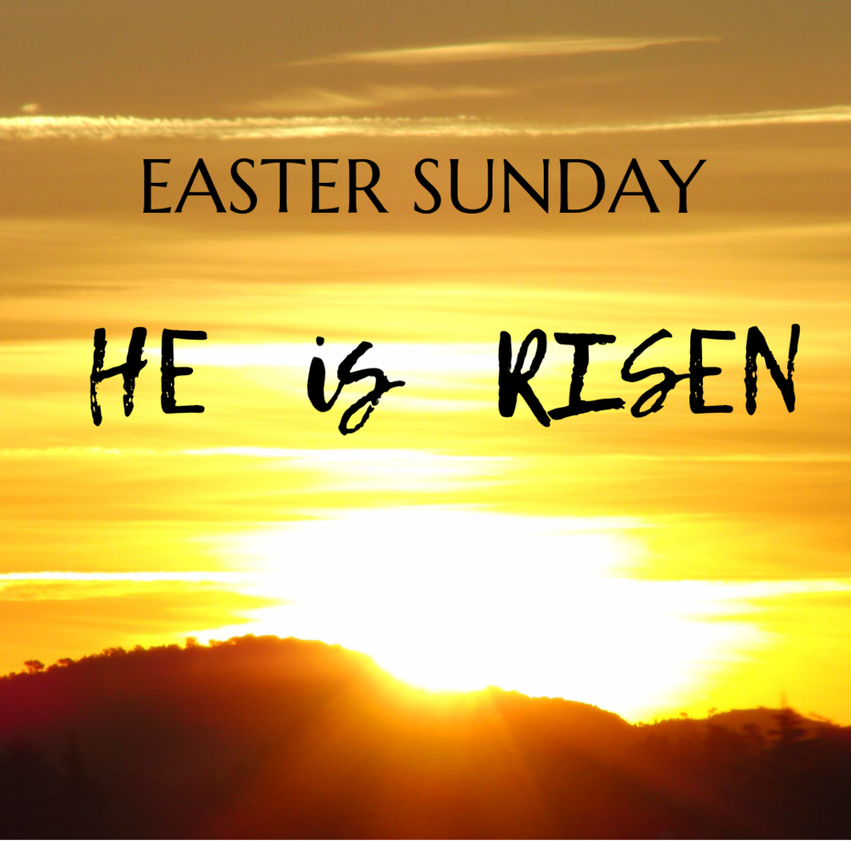

Slide 3
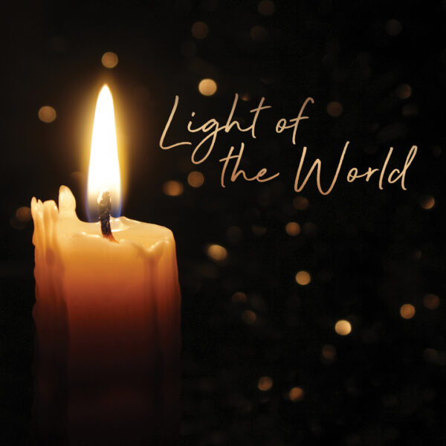

Slide 4
He is Risen Indeed!

Slide 5
The Lord be with you
And also with you

Slide 6
Let us
pass the peace

Slide 7
Keith Green song

Slide 9
1 Keep me safe, O God, for in You I take refuge.
2 I said to the LORD,
"You are my Lord; apart from You I have no good thing"

Slide 10
3 As for the saints who are in the land
they are the glorious ones in
whom is all my delight.
4 The sorrows of those will increase who run after other gods. I will not pour out their libations of blood or take up their names on my lips

Slide 11
5 LORD, You have assigned me
my portion and my cup; You have made my lot secure.
6 The boundary lines have fallen
for me in pleasant places; surely I have a delightful inheritance

Slide 12
7 I will praise the LORD,
who counsels me; even at night my heart instructs me.
8 I have set the LORD always before me. Because He is at my right hand, I will not be shaken.

Slide 13
9 Therefore my heart is glad
and my tongue rejoices; my body also will rest secure,
10 because You will not
abandon me to the grave,
nor will You let Your Holy One see decay.

Slide 14
11 You have made known
to me the path of life; You will fill me with joy
in Your presence, with eternal pleasures
at Your right hand.
Amen.

Slide 17
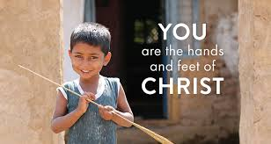

Slide 18
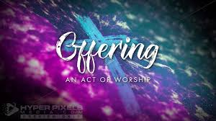

Slide 20
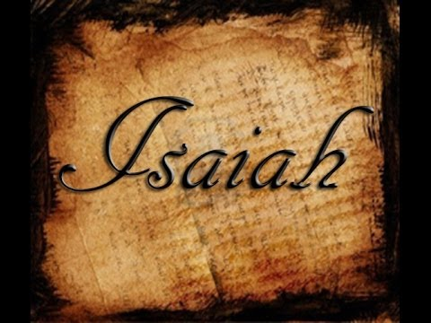

Slide 21
⁶ On this mountain the Lord Almighty will prepare a feast of rich food for all peoples, a banquet of aged wine— the best of meats and the finest of wines. ⁷ On this mountain he will destroy the shroud that enfolds all peoples, the sheet that covers all nations;

Slide 22
⁸ he will swallow up death forever. The Sovereign Lord will wipe away the tears from all faces; He will remove his people’s disgrace
from all the earth. The Lord has spoken.

Slide 23
⁹ In that day they will say,
“Surely this is our God; we trusted in Him, and He saved us. This is the Lord, we trusted in Him; let us rejoice and be glad in His salvation.”

Slide 25
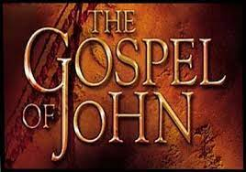

Slide 26
Early on the first day of the week, while it was still dark, Mary Magdalene went to the tomb and saw that the stone had been removed from the entrance.
² So she came running to Simon Peter and the other disciple, the one Jesus loved, and said, “They have taken the Lord out of the tomb, and we don’t know where they have put him!”
³ So Peter and the other disciple started for the tomb.
⁴ Both were running, but the other disciple outran Peter and reached the tomb first.

Slide 27
⁵ He bent over and looked in at the strips of linen lying there but did not go in. ⁶ Then Simon Peter came along behind him and went straight into the tomb. He saw the strips of linen lying there, ⁷ as well as the cloth that had been wrapped around Jesus’ head. The cloth was still lying in its place, separate from the linen. ⁸ Finally the other disciple, who had reached the tomb first, also went inside. He saw and believed. ⁹ (They still did not understand from Scripture that Jesus had to rise from the dead.)

Slide 28
¹⁰ Then the disciples went back to where they were staying.
Jesus Appears to Mary Magdalene
¹¹ Now Mary stood outside the tomb crying. As she wept, she bent over to look into the tomb
¹² and saw two angels in white, seated where Jesus’ body had been, one at the head and the other at the foot.
¹³ They asked her, “Woman, why are you crying?”
“They have taken my Lord away,” she said,
“and I don’t know where they have put him.”

Slide 29
¹⁴ At this, she turned around and saw Jesus standing there, but she did not realize that it was Jesus.
¹⁵ He asked her, “Woman, why are you crying?
Who is it you are looking for?”
Thinking he was the gardener, she said, “Sir, if you have carried him away, tell me where you have put him, and I will get him.”
¹⁶ Jesus said to her, “Mary.”
She turned toward him and cried out in Aramaic, “Rabboni!” (which means “Teacher”).

Slide 30
¹⁷ Jesus said, “Do not hold on to me, for I have not yet ascended to the Father. Go instead to my brothers and tell them, ‘I am ascending to my Father and your Father, to my God and your God.’”
¹⁸ Mary Magdalene went to the disciples with the news: “I have seen the Lord!” And she told them that he had said these things to her.

Slide 32
Christ, the Lord, is risen today,
Alleluia! Sons of men and angels say,
Alleluia! Raise your joys and triumphs high
Alleluia! Sing, ye heavens, and earth, reply,
Alleluia!

Slide 33
Love's redeeming work is done,
Alleluia! Fought the fight, the battle won,
Alleluia! Vain the stone, the watch, the seal
Alleluia! Lo! He sets in blood no more,
Alleluia!

Slide 34
Lives again our glorious King,
Alleluia! Where, O death, is now thy sting?
Alleluia! Once He died our souls to save,
Alleluia! Where your victory, O grave?
Alleluia!

Slide 35
Soar we now where Christ has led
Alleluia! Following our exalted Head,
Alleluia! Made like Him, like Him we rise,
Alleluia! Ours the cross, the grave, the skies
Alleluia!

Slide 37
Early on the first day of the week, WHILE IT WAS STILL DARK Nicodemus went out at night? And being scared of the religious she did what the law said, no visits on the Sabbath,
Mary Magdalene went to the tomb and SAW THAT THE STONE HAD BEEN REMOVED FROM THE ENTRANCE. In Mark’s account they brought spices, but Joseph of Arimathea took care of that. Imagine how they would feel.

Slide 38
² So she came running to Simon Peter and the other disciple, legal witness under Torah law, women have no legal status, the one Jesus loved, no evidence of who this is, and said, “They have taken the Lord out of the tomb, bodies don’t just disappear, and we don’t know where they have put him!” perfectly logical to assume this, there are tomb robbers, maybe holding him ransom. What do you then feel??
³ So Peter and the other disciple started for the tomb. Is this the cavalry? We’ll find him …..

Slide 39
⁴ Both were running, but the other disciple outran Peter and reached the tomb first. ⁵ He, the other, bent over and looked in at the strips of linen lying there but did not go in. ⁶ Then Simon Peter came along behind him and went straight into the tomb, he walked on water…. He said lets make 3 tents …He denied…...
He saw the strips of linen lying there, ⁷ as well as the cloth that had been wrapped around Jesus’ head. The cloth was still lying in its place, SEPARATE from the linen.

Slide 40
⁸ Finally!!!! the other disciple, who had reached the tomb first, also went inside. Two witnesses, as before. He saw and believed. What?? Mary’s story? ⁹ (They still did not understand from Scripture that Jesus had to (must, is necessary) rise from the dead.) ¹⁰ Then the disciples went back to where they were staying. As you do…
Why would they do this??

Slide 41
Jesus Appears to Mary Magdalene
¹¹ Now Mary stood outside the tomb crying.
As she wept, SHE BENT OVER to look into the tomb ¹² and saw two angels, like on the mercy seat on the ark of the Covenant, in white, SEATED where Jesus’ body had been, one at the head and the other at the foot.

Slide 42
¹³ They asked her, “Woman, why are you crying?”
“THEY, soldiers, leaders, robbers, have taken my Lord away,” she said, “and I don’t know where they have put him.” struggling here….
¹⁴ At this, she turned around and saw Jesus standing there, but she did not realize that it was Jesus. Too much, or soooo much going on … Has Jesus been Glorified or transfigured and gleaming brightly…..

Slide 43
¹⁵ He asked her, “Woman, why are you crying?
Who is it you are looking for?”
Thinking he was the gardener, she said, “Sir, if you have carried him away, tell me where you have put him, and I will get him.” pleading or desperate ….. He has been dishonour unto death, she is putting things right by honouring him in his death.

Slide 44
¹⁶ Jesus said to her, “Mary.” One word ! His voice
She turned toward him and cried out in Aramaic,
“Rabboni!” (which means “Teacher”). She is the 1st witness and first to tell of his resurrection.
¹⁷ Jesus said, “Do not hold on to me, for I have not yet ascended to the Father. Go instead to my brothers and tell them, ‘I am ascending to my Father and your Father, to my God and your God.’”

Slide 45
¹⁸ Mary Magdalene went to the disciples with the news: “I have seen the Lord!” And she told them that he had said these things to her.

Slide 49
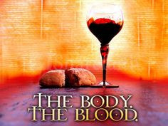
DO THIS IN REMEMBRANCE OF ME.

Slide 50
Here, Lord we take the broken bread
And drink the wine, believing
That by your life our souls are fed,
Your parting gifts receiving.
1/2

Slide 51
As You have given, so we would give
Ourselves for others’ healing;
As You have lived, so we would live
The Father’s love revealing.
2/2

Slide 53
Holy, holy, holy Lord,
God of power and might,
Heaven and earth
are full of your glory.
Hosanna in the highest.

Slide 54
Blessed is He
who comes in the name of the Lord.
Hosanna in the highest.

Slide 56
Our Father in heaven,
hallowed be Your name,
Your kingdom come,
Your will be done
On earth as in heaven.
Give us today our daily bread.

Slide 57
And forgive us our sins,
As we forgive those
who sin against us.
Save us from the time of trial,
And deliver us from evil.
For the kingdom, the power
and the glory are Yours,
Now and forever. Amen.

Slide 61
Thine be the glory,
risen, conquering Son; endless is the victory,
Thou o'er death hast won; angels in bright raiment
rolled the stone away, kept the folded grave clothes
where thy body lay.

Slide 62
Thine be the glory,
Risen conquering Son, Endless is the vict'ry,
Thou o'er death hast won.

Slide 63
Lo! Jesus meets us,
risen from the tomb; Lovingly He greets us,
scatters fear and gloom; let the Church with gladness,
hymns of triumph sing; for her Lord now liveth,
death hath lost its sting.

Slide 64
Thine be the glory,
Risen conquering Son, Endless is the vict'ry,
Thou o'er death hast won.

Slide 65
No more we doubt Thee,
glorious Prince of life; life is naught without Thee;
aid us in our strife; make us more than conquerors,
through Thy deathless love: bring us safe through Jordan
to Thy home above.

Slide 66
Thine be the glory,
Risen conquering Son, Endless is the vict'ry,
Thou o'er death hast won. Words: Edmond Budry (1854-1932), 1884; trans. Richard Hoyle (1875-1939), 1923;

Slide 69
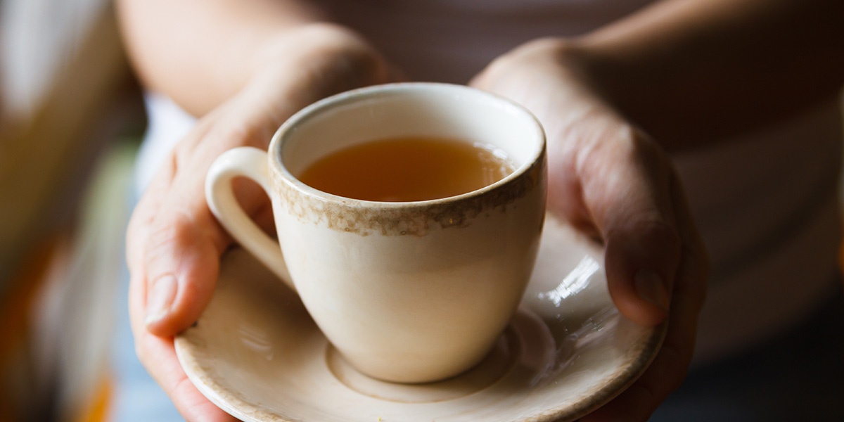
Good
Morning
CHRIST IS Risen

